Slide 1

Prevalence and Factors associated with Depression and Anxiety among undergraduate students in Barishal University : A Cross-Sectional study.
Presented By
UMME KULSUM
Class Roll : 19 STA 002
Session : 2018-19
Presented for:
Dr. Tania Islam
Assistant Professor,
Computer science & Engineering
University of Barishal.
Department of statistics, University of Barishal
Barishal-8254, Banglaesh
15 November,2024

Slide 2
Outline
Introduction
Research problem and motivation
Objectives
Sampling design
Methodology
Results and discussion
Conclusion and recommendations
References
UMME KULSUM
15 November,2024 2/28

Slide 3
Introduction
Background of the study
"Health is a state of complete physical, mental, and social well-being and not merely the absence of disease or infirmity," according to the definition provided by the World Health Organization.
Many individuals neglect the significance of mental health because they believe that being health means being physically good and free from illness. As a result, mental well-being is a crucial component of a healthy life.
Depression and anxiety are regarded as major indicators of mental health in the community. Depression and anxiety are serious mental health problem that can have an impact on person’s day-to-day life . Unfortunately, if these mental illnesses are not identified and treated, mental health disorders may rise.
The university life of a student is the most emotionally and intellectually stressful period of their life. A student experiences a great deal of obstacles at this stage that can lead to physical, social and emotional difficulties.
UMME KULSUM
15 November,2024 3/28

Slide 4
Research Problem and Motivation
Research Problem and Motivation
The prevalence of depression and anxiety among undergraduate students become a major global health concern, affecting both their general well-being and academic performance. This study aims to investigate the prevalence of depression and anxiety and associated factors among Barishal University students.
The motivation for undertaking this study stems from a genuine concern for the well-being of undergraduate students at Barisal University. As the university environment plays an important role in the development of young people's lives, it is important to create a supportive atmosphere that supports both academic and mental well-being. By gaining insights into the specific factors influencing depression and anxiety in this context, we aim to contribute valuable knowledge that can inform the development of targeted interventions.
Furthermore, the motivation is grounded in the belief that tackling mental health issues at Barisal University will not only benefit the current student population but will also have a positive impact on the university community as a whole.
UMME KULSUM
15 November,2024 4/28

Slide 5
Literature Review
Literature Review
Depression and anxiety symptoms are reported to be common among university students in many reasons of the world.
Nuran Bayram, Nazan Bilgel (2008) identify the prevalence of anxiety, depression and stress among a group of Turkish university students. This study examines that Anxiety and stress scores were higher among female students and first and second-year students had higher depression, anxiety and stress scores than the others. The prevalence of depression, anxiety and stress levels of moderate severity or over were found in 27.1%, 47.1% and 27% respectively.
Md. Akhtarul Islam et al.,2020 identify the determinants of depression and anxiety among university students during the COVID-19 pandemic in Bangladesh. This study suggest that students were experiencing mild to severe depression 82.4% and anxiety 87.7%. Academic, financial insecurity and professional uncertainty raise depression and anxiety among university students.
UMME KULSUM
15 November,2024 5/28

Slide 6
Literature Review
Literature Review
Saiful Islam et al. (2020) determine the prevalence and factors associated with depression and anxiety among first-year students in Bangladesh. They observe that the prevalence rates of moderate to extremely severe level of depression and anxiety were 69.5% and 61%, respectively, without gender difference. Unsatisfactory sleep quality, lack of physical exercise was main risk factor for depression and the main risk factor for anxiety were excessive internet use in this study and first year students face ragging and other problems, which make them more susceptible to mental illness.
Choon Khim Teh et al. (2015) investigates the prevalence of stress, anxiety and depression among undergraduate students in Melaka Manipal Medical College in Malaysia. In this study, prevalence rates for moderate to extremely severe stress, anxiety and depression are 16.6%, 55.5%, and 30.7% respectively. This study indicates strong associations between social life, relationship status and total family income per month with depression and anxiety associated with only ethnicity
UMME KULSUM
15 November,2024 6/28

Slide 7
Objectives
Objectives
To determine the prevalence of depression and anxiety among Barishal University students.
To identify associated factors contributing to depression and anxiety among the students.
UMME KULSUM
15 November,2024 7 //28

Slide 8
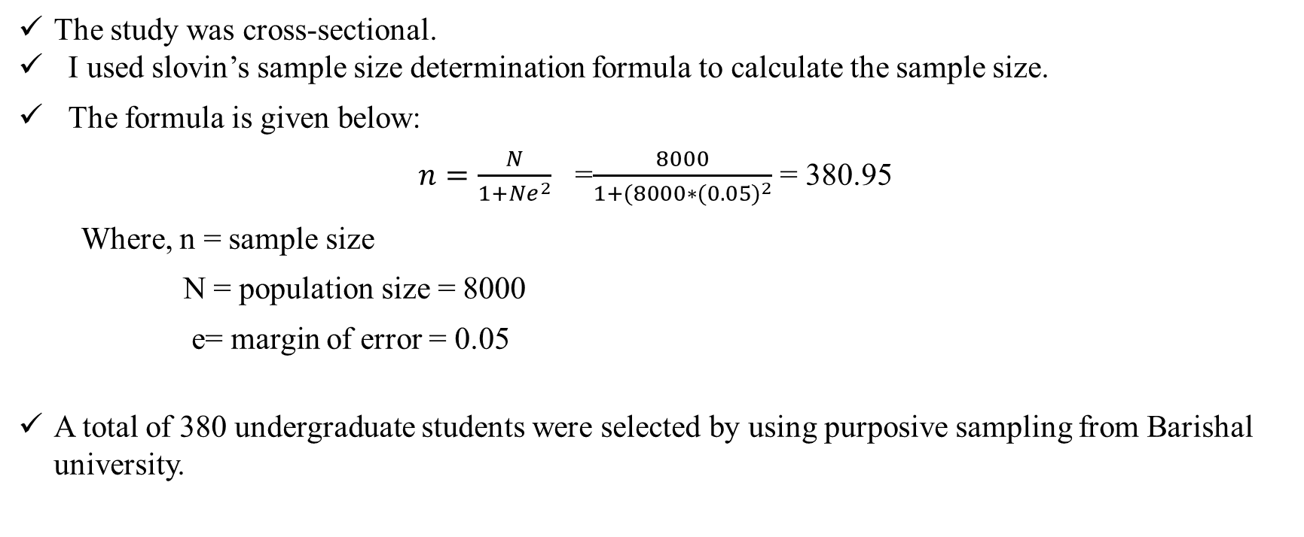
Sampling design
Sampling design
The study was cross-sectional.
I used slovin’s sample size determination formula to calculate the sample size.
The formula is given below:
$n=\frac{N}{1+Ne^{2}}$ =$\frac{8000}{1+(8000∗({0.05)}^{2}}$ = 380.95
Where, n = sample size
N = population size = 8000
e= margin of error = 0.05
A total of 380 undergraduate students were selected by using purposive sampling from Barishal university.
UMME KULSUM
15 November,2024 8/28

Slide 9
Methodology
Methodology
A structured questionnaire was used to collect data on socio-demographic characteristics , academic workload, social support, financial concerns and lifestyle habits.
The Patient Health questionnaire-9 (PHQ-9) and Generalized Anxiety Disorder-7 (GAD-7) was used to assess the level of depression and anxiety respectively.
The data were analyzed using IBM SPSS, python programming and Microsoft Excel .
Descriptive statistics will be used to determine the prevalence of depression and anxiety.
Inferential statistics, such as chi-square test , binary logistic regression were used to identify factors associated with this condition with 95% level of significance.
The machine learning approaches such as Random Forest Decision tree are used to identify the risk factors for depression and anxiety.
UMME KULSUM
15 November,2024 9/28

Slide 10
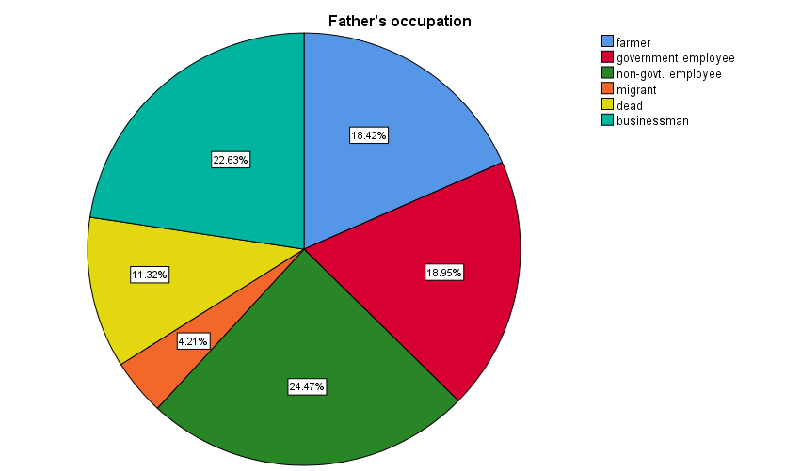
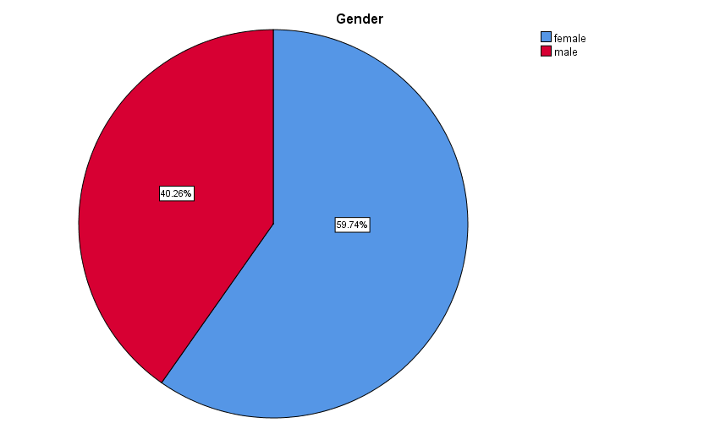
Results and Discussion
Descriptive statistics
Figure 2: pie chart of the respondents by their father’s occupation.
Figure 1: pie chart of the respondents by their sex
UMME KULSUM
15 November,2024 10/28

Slide 11
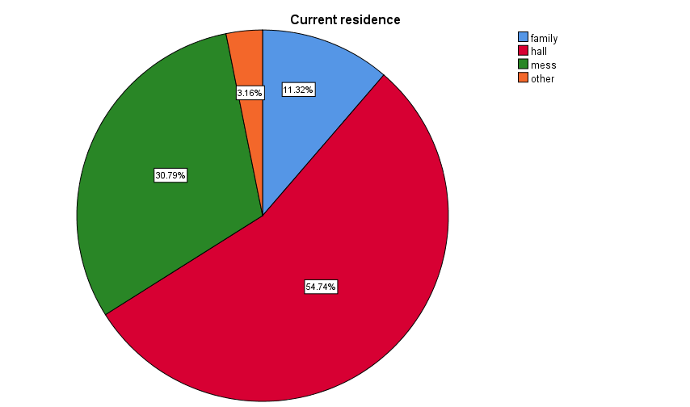
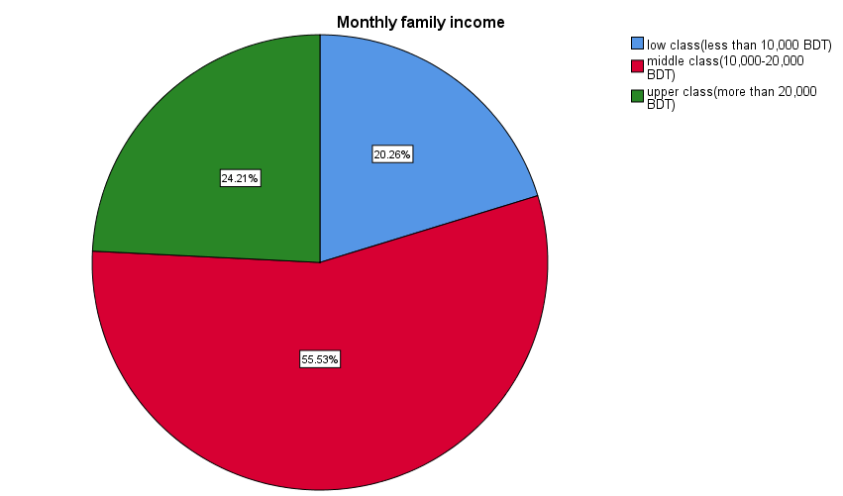
Results and Discussion
Descriptive statistics
Figure3: pie chart of the respondents by their monthly family income
Figure 4: pie chart of the respondents by their current residence
UMME KULSUM
November 15,2024 11/28

Slide 12

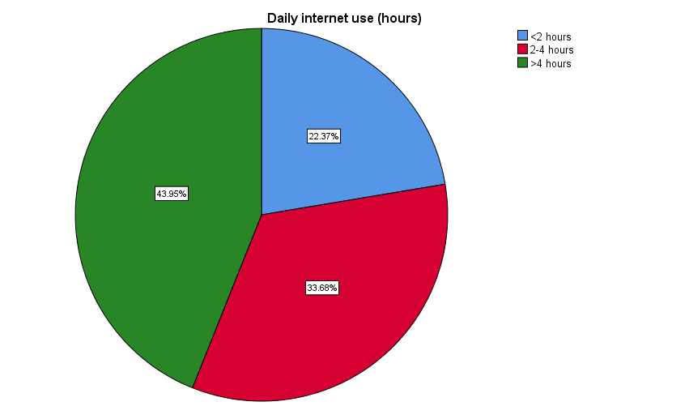
Results and Discussion
Descriptive statistics
Figure 5: pie chart of the respondents by their engaged in physical exercise
Figure 6: pie chart of the respondents by their daily internet use (hours)
UMME KULSUM
November 15,2024 12/28

Slide 13
Results and Discussion
Descriptive statistics
Table 1:descriptive statistics
 | Frequency | Percentage
Marital status
single | 259 | 68.2
In a relationship | 75 | 19.7
Breakup then single | 20 | 5.3
Married | 26 | 6.8
Studying year
1st year | 55 | 14.5
2nd year | 112 | 29.5
3rd year | 103 | 27.1
4th year | 110 | 28.9
Satisfaction with education
no | 191 | 50.3
yes | 189 | 49.7
Sleeping status
less than normal | 163 | 42.9
normal (7-8 hour) | 198 | 52.1
more than normal | 19 | 5.0
Sleeping satisfaction
no | 162 | 42.6
yes | 218 | 57.4
 | Frequency | Percentage
Satisfaction with subject
no | 156 | 41.1
yes | 224 | 58.9
Dissatisfaction with current education, financial condition and future career
no | 139 | 36.6
yes | 241 | 63.4
UMME KULSUM
November 15,2024 13/28

Slide 14
Results and Discussion
Chi-square test for independence
Association between depression and physical exercise
we observed that from the result the asymptotic significant (2-sided) value of the both Pearson Chi-Square and Likelihood Ratio with 1 df are 0.00. Hence the test is significant at 5% level of significance.
Thus, we conclude that there exist an association between depression and physical exercise of the respondents.
Chi-Square Tests
 | Value | df | Asymptotic Significance (2-sided) | Exact Significance. (2-sided) | Exact Significance. (1-sided)
Pearson Chi-Square | 117.395ª | 1 | 0.000
Continuity Correction | 115.114 | 1 | 0.000
Likelihood Ratio | 130.595 | 1 | 0.000
Fisher's Exact Test |  |  |  | 0.000 | 0.000
Linear-by-Linear Association | 117.087 | 1 | 0.000
N of Valid Cases | 380
UMME KULSUM
November 15,2024 14/28

Slide 15
Results and Discussion
Chi-square test for independence
Association between depression and sleeping satisfaction
we observed that from the result the asymptotic significant (2-sided) value of the both Pearson Chi-Square and Likelihood Ratio with 1 df are 0.00. Hence the test is significant at 5% level of significance.
Thus, we conclude that there exist an association between depression and sleeping satisfaction of the respondents.
Chi-Square Tests
 | Value | df | Asymptotic Significance (2-sided) | Exact Significance (2-sided) | Exact Significance (1-sided)
Pearson Chi-Square | 186.871 | 1 | 0.000
Continuity Correction | 184.030 | 1 | 0.000
Likelihood Ratio | 204.806 | 1 | 0.000
Fisher's Exact Test |  |  |  | 0.000 | 0.000
Linear-by-Linear Association | 186.380 | 1 | 0.000
N of Valid Cases | 380
UMME KULSUM
November 15,2024 15/28

Slide 16
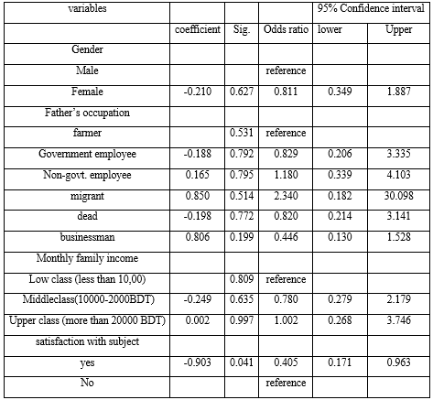
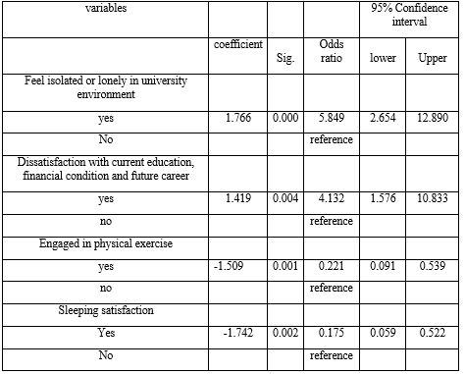
Results and Discussion
Binary logistic regression for depression
UMME KULSUM
November 15,2024 16/28

Slide 17
Results and Discussion
Binary logistic regression for depression
Form the previous table, we observed that satisfaction with subject, feel isolated or lonely in university environment, dissatisfaction with current education, financial condition and future career, engaged in physical exercise and Sleeping satisfaction are significant at 5% level of significance. So, these factors are associated with depression.
we can say that the respondents having satisfactory sleep quality were 0.175 times less likely than the respondents having unsatisfactory sleep quality to be depressed (OR=0.175, CI=0.059-0.522). That the respondents engaging in physical exercise were 0.221 times less likely than the respondents not engaging in physical exercise to be depressed (OR=0.221, CI=0.091-0.539).
UMME KULSUM
November 15,2024 17/28

Slide 18
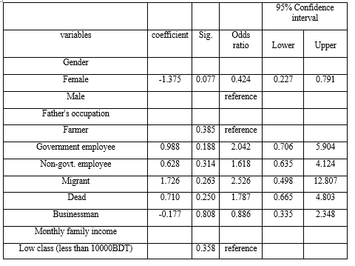
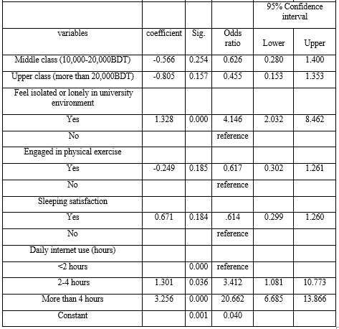
Results and Discussion
Binary logistic regression for anxiety
UMME KULSUM
November 15,2024 18/28

Slide 19
Results and Discussion
Binary logistic regression for anxiety
Form the previous table, we observed that feel isolated or lonely in university environment, daily internet use is significant at 5% level of significance. So, these factors are associated with anxiety and no statistically significant association was found between any of the socio-demographic variables.
From this table, we can say that the respondents using the internet more than 4 hours were 20.662 times more likely than the respondents using the internet less than <2 hours daily to be depressed (OR=20.662, CI=6.685-13.866). The respondents using the internet 2- 4 hours were 3.412 times more likely than the respondents using the internet less than <2 hours daily to be depressed (OR=3.412, CI=1.081-10.773).
UMME KULSUM
November 15,2024 19/28

Slide 20
Results and Discussion
Random Forest Analysis
The random forest model for depression achieved an accuracy of 90 % on the testing data. Precision and recall values for each class were 93% and 84%, indicating a strong predictive performance for identifying students at risk of depression.
The random forest model for anxiety achieved an accuracy of 78 % on the testing data. Precision and recall values for each class were 90% and 55% indicating a strong predictive performance for identifying students at risk of anxiety.
UMME KULSUM
November 15,2024 20/28

Slide 21
Results and Discussion
Random Forest Analysis
The random forest analysis identified key predictors associated with depression and anxiety among students. The most influential variables for depression were satisfaction with the subject, feeling isolated or lonely in the university environment, dissatisfaction with a future career, financial condition and current education, engaging in physical exercise and sleeping satisfaction.
The most influential variables for anxiety were feel isolated or lonely in university environment, dissatisfaction with their future career, financial condition and current education, daily internet use
UMME KULSUM
November 15,2024 21/28

Slide 22
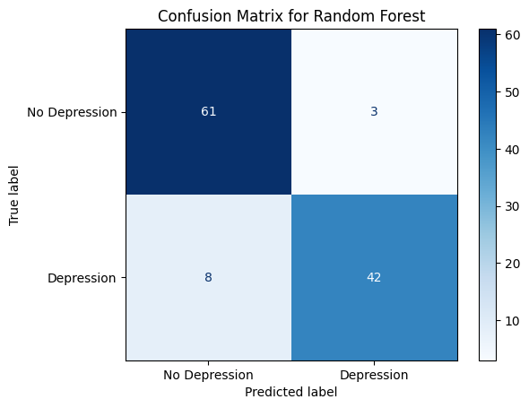
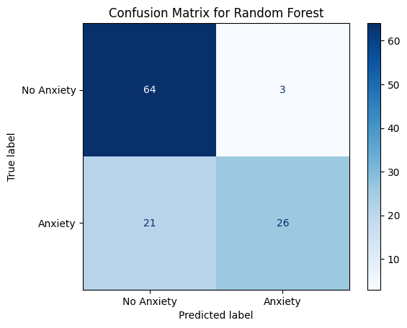
Results and Discussion
Random Forest Analysis
UMME KULSUM
November 15,2024 21/28

Slide 23
Results and Discussion
Decision Tree Analysis
The decision tree provided a hierarchical view of the factors contributing to depression and anxiety, interpretative manner.
The first splitting node in the decision tree was daily internet use, separating students into low-risk and high-risk groups based on their online engagement.
For students who had high daily internet use, factors like academic workload and family income appeared as additional nodes. These branches highlighted those students with both high internet use and high academic workload had an increased likelihood of experiencing depression or anxiety. The tree structure visually represented interactions between predictors, revealing how certain combinations of factors elevate mental health risks.
UMME KULSUM
November 15,2024 22/28

Slide 24
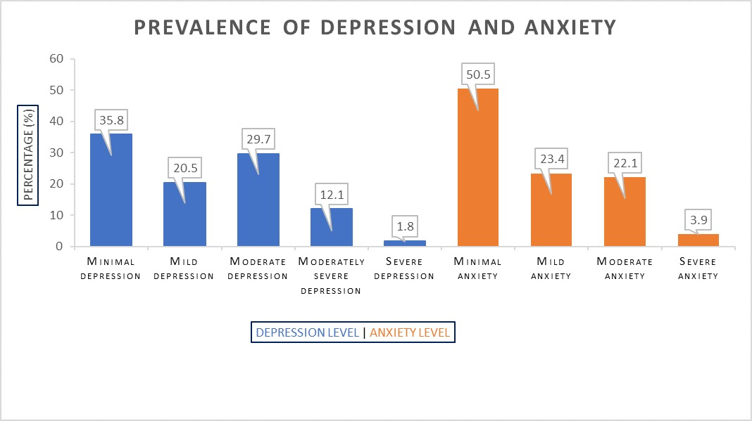
Results and Discussion
Prevalence of Depression and Anxiety
UMME KULSUM
November 15,2024 23/28

Slide 25
Conclusion and Recommendations
Conclusion and Recommendations
University students’ mental health is a global issue in a developed or developing country. Mental health illness among undergraduate students at a university is neglected public health problem in Bangladesh.
In the present study, the majority of respondents were from middle class families and maximum students did not take regular physical exercise.
This study showed that the prevalence rates of moderate to extremely severe levels of depression and anxiety are 43.6% and 26% respectively and highlighted a number of risk factors that are significantly associated with depression and anxiety (i.e., feeling loneliness, lack of physical exercise, Dissatisfaction with current education, financial condition and future career, excessive internet use, lack of sleep satisfaction-that are associated in and themselves).
UMME KULSUM
November 15,2024 24/28

Slide 26
Conclusion and Recommendations
Conclusion and Recommendations
Considering the prevalence rates of depression and anxiety found among Barishal University students, University authorities and healthcare professionals need their attention drawn so that such illnesses can be prevented and to raise students’ awareness about mental health, intake physical exercise, better sleep quality, and the moderate use of internet. Mental health related programs should be organized on Barishal University campus to raise awareness among the students.
UMME KULSUM
November 15,2024 25/28

Slide 27
References
References
Abdallah, A. R., & Gabr, H. M. (2014). Depression, anxiety and stress among first year medical students in an Egyptian public university. International Research Journal of Medicine and Medical Sciences, 2(1), 11–19.
Alim, S. A. H., Rabbani, M. G., Karim, E., Mullick, M. S., Mamun, A., et al. (2017). Assessment of depression, anxiety and stress among first year MBBS students of a public medical college, Bangladesh. Bangladesh Journal of Psychiatry, 29(1), 23–29.
Ahmad A Mirza, Mukhtiar Baig, Ghada M Beyari, Mohammed Aiman Halawani & Abdulrahim A Mirza (2022). Depression and Anxiety Among Medical Students: A Brief Overview. https://www.tandfonline.com/action/journalInformation?journalCode=dame20
UMME KULSUM
November 15,2024 26/28

Slide 28
References
References
Choon Khim Teh, Choon Wei Ngo, Rashidatul Aniyah binti Zulkifli, Rammiya Vellasamy, Kelvin Suresh (2015). Depression, Anxiety and Stress among Undergraduate Students: A Cross Sectional Study. Open Journal of Epidemiology, 2015, 5, 260-268.
Kevin WC Lun, CK Chan, Patricia KY Ip, Samantha YK Ma, WW Tsai, CS Wong, Christie HT Wong, TW Wong, D Yan (2018). Depression and anxiety among university students in Hong Kong. Li Ka Shing Faculty of Medicine, The University of Hong Kong, Pokfulam, Hong Kong
Mamun, M. A., Hossain, M. S., & Griffiths, M. D. (2019). Mental health problems and associated predictors among Bangladeshi students. International Journal of Mental Health and Addiction., 1–15. https://doi. org/10.1007/s11469-019-00144-8.
UMME KULSUM
November 15,2024 27/28

Slide 29
Thank you !
UMME KULSUM
November 15,2024 28/28

